Slide 1
FOUR VEDAS OF INDIA
Aishwarya Kadam (14422)
Priyanka Khandagale (14440)

Slide 2
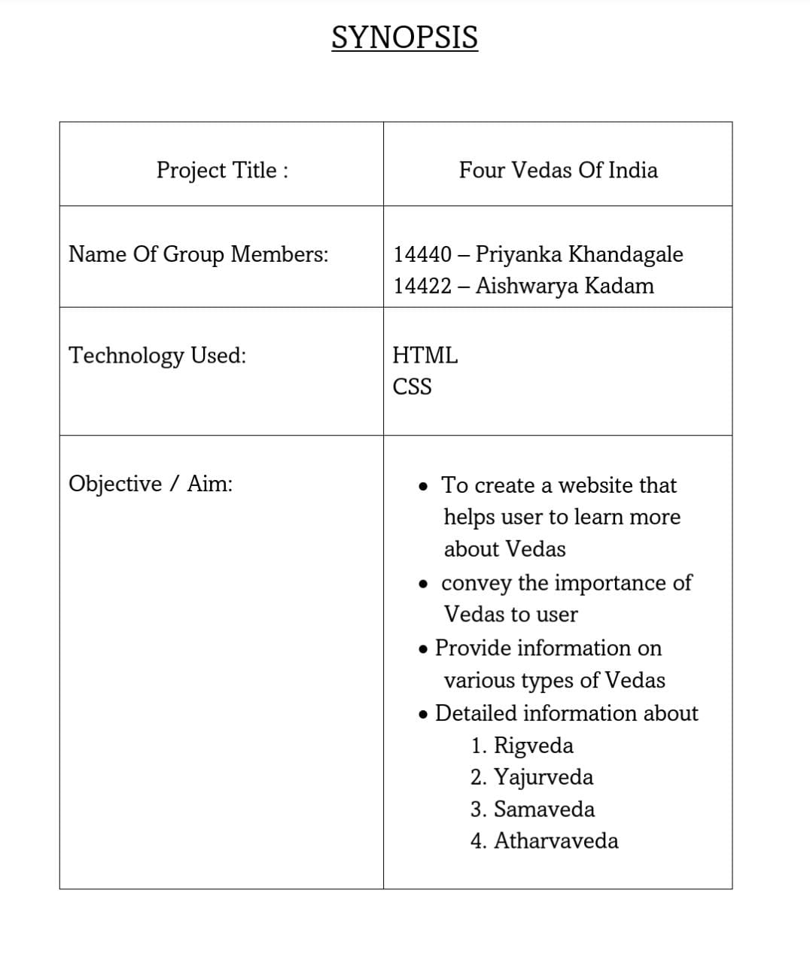

Slide 3
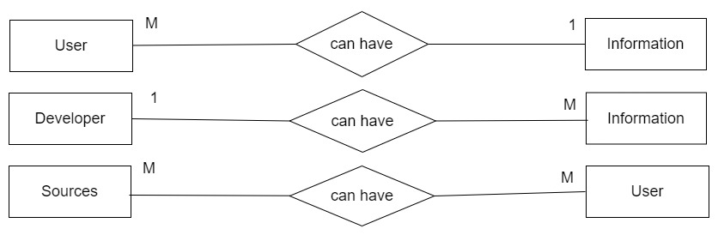
SYATEM DESIGN:
ERD:

Slide 4
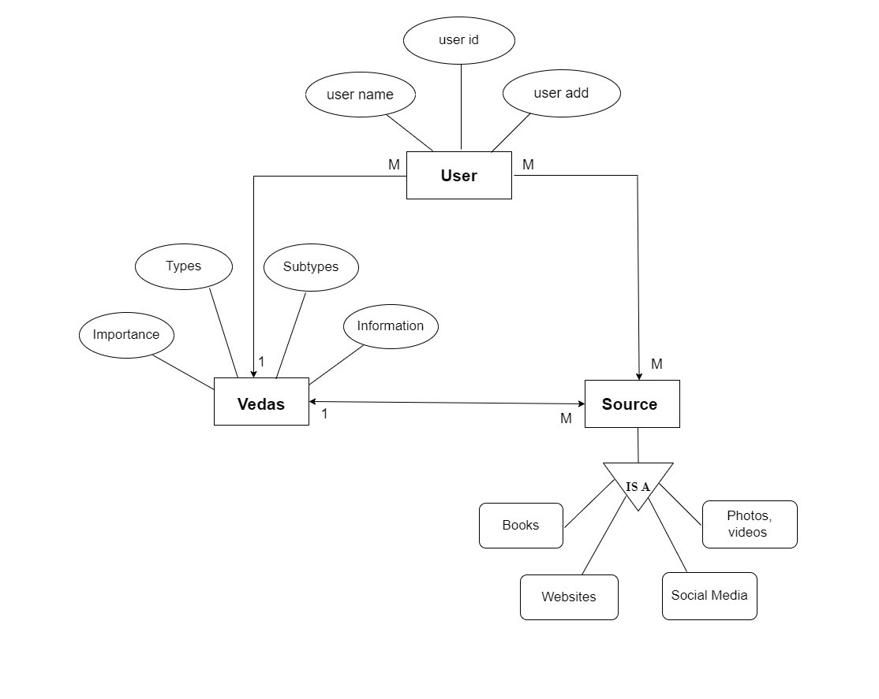
ERD:

Slide 5
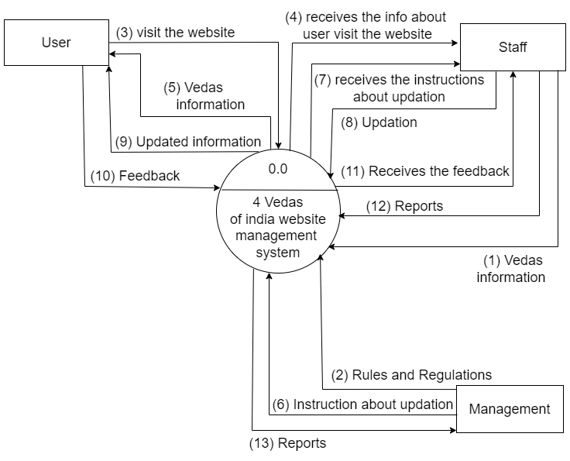
DFD:

Slide 6
Layout of the website
Home page
More page
Types pages
Sources page
Contact page

Slide 7
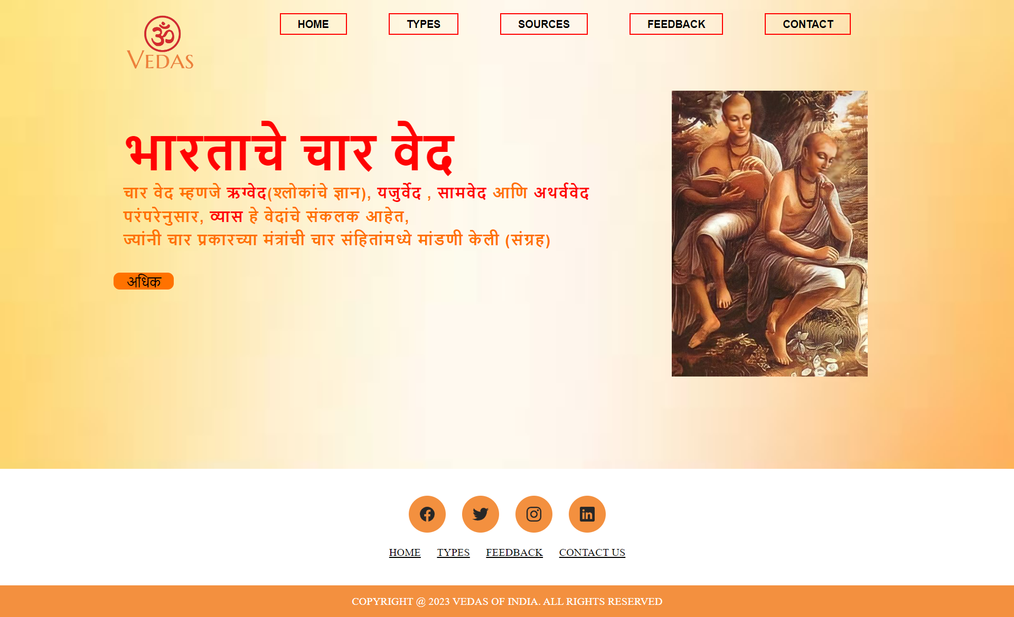
Home page:

Slide 8
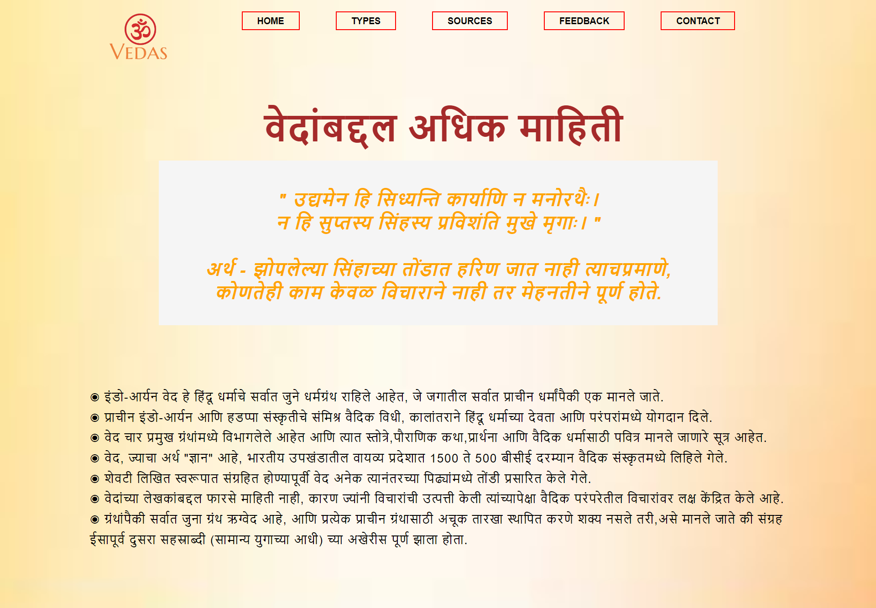
More Information Page:

Slide 9
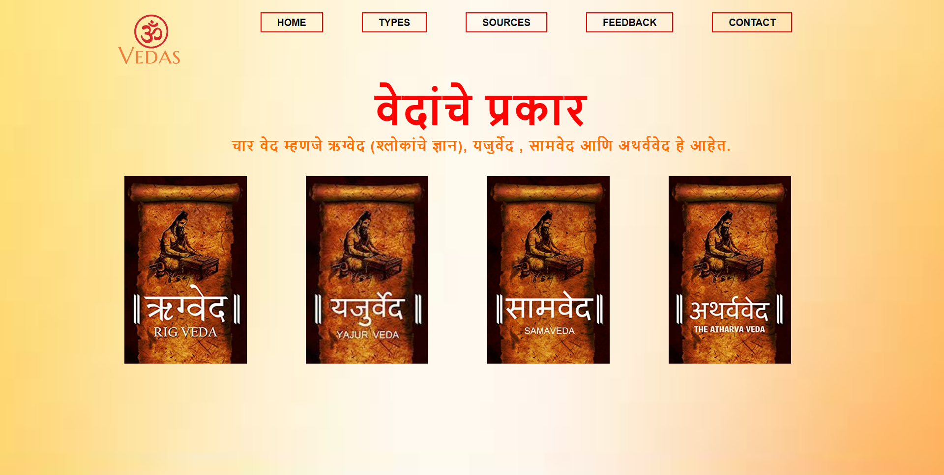
Types Page:

Slide 10
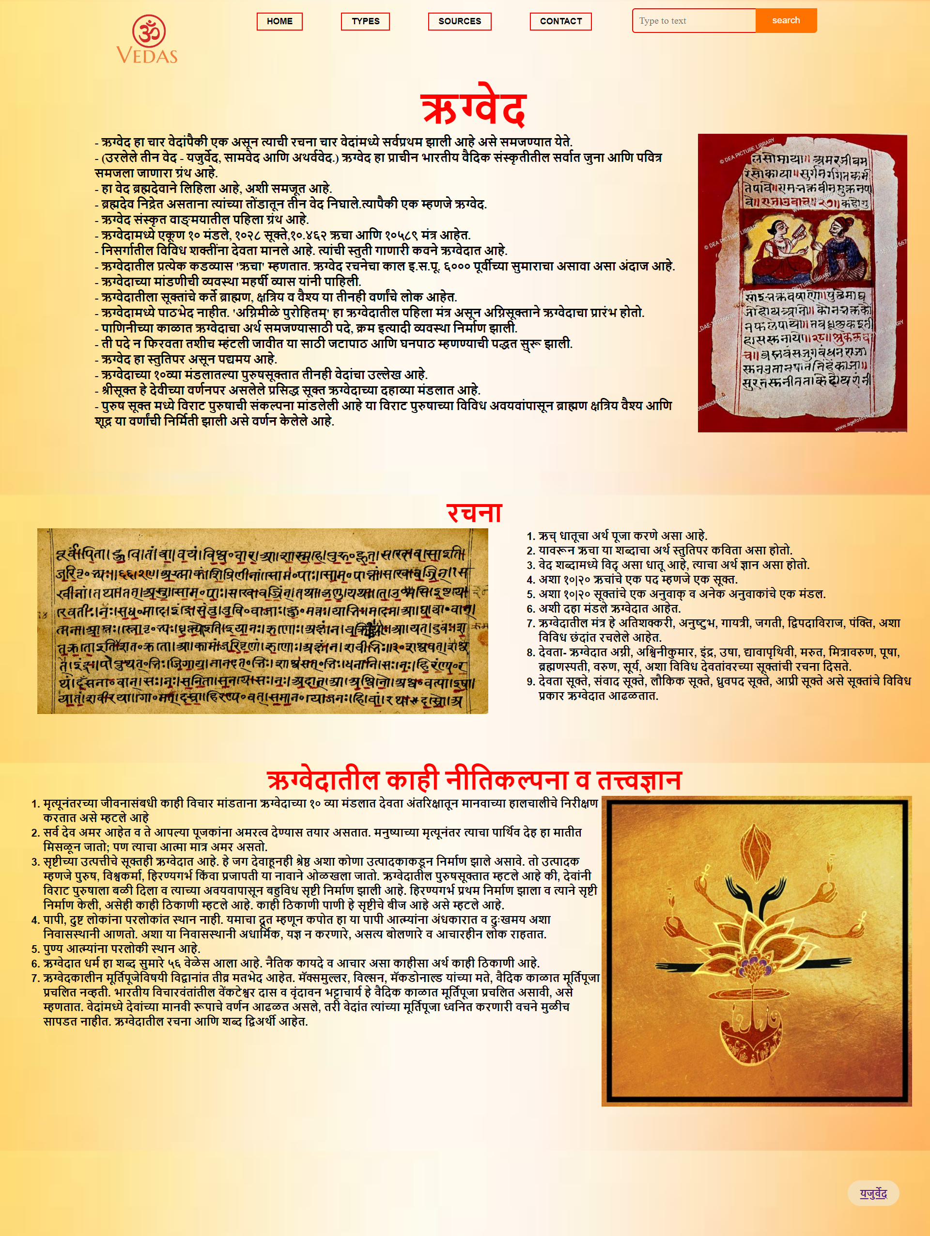
Rigveda Page:

Slide 11
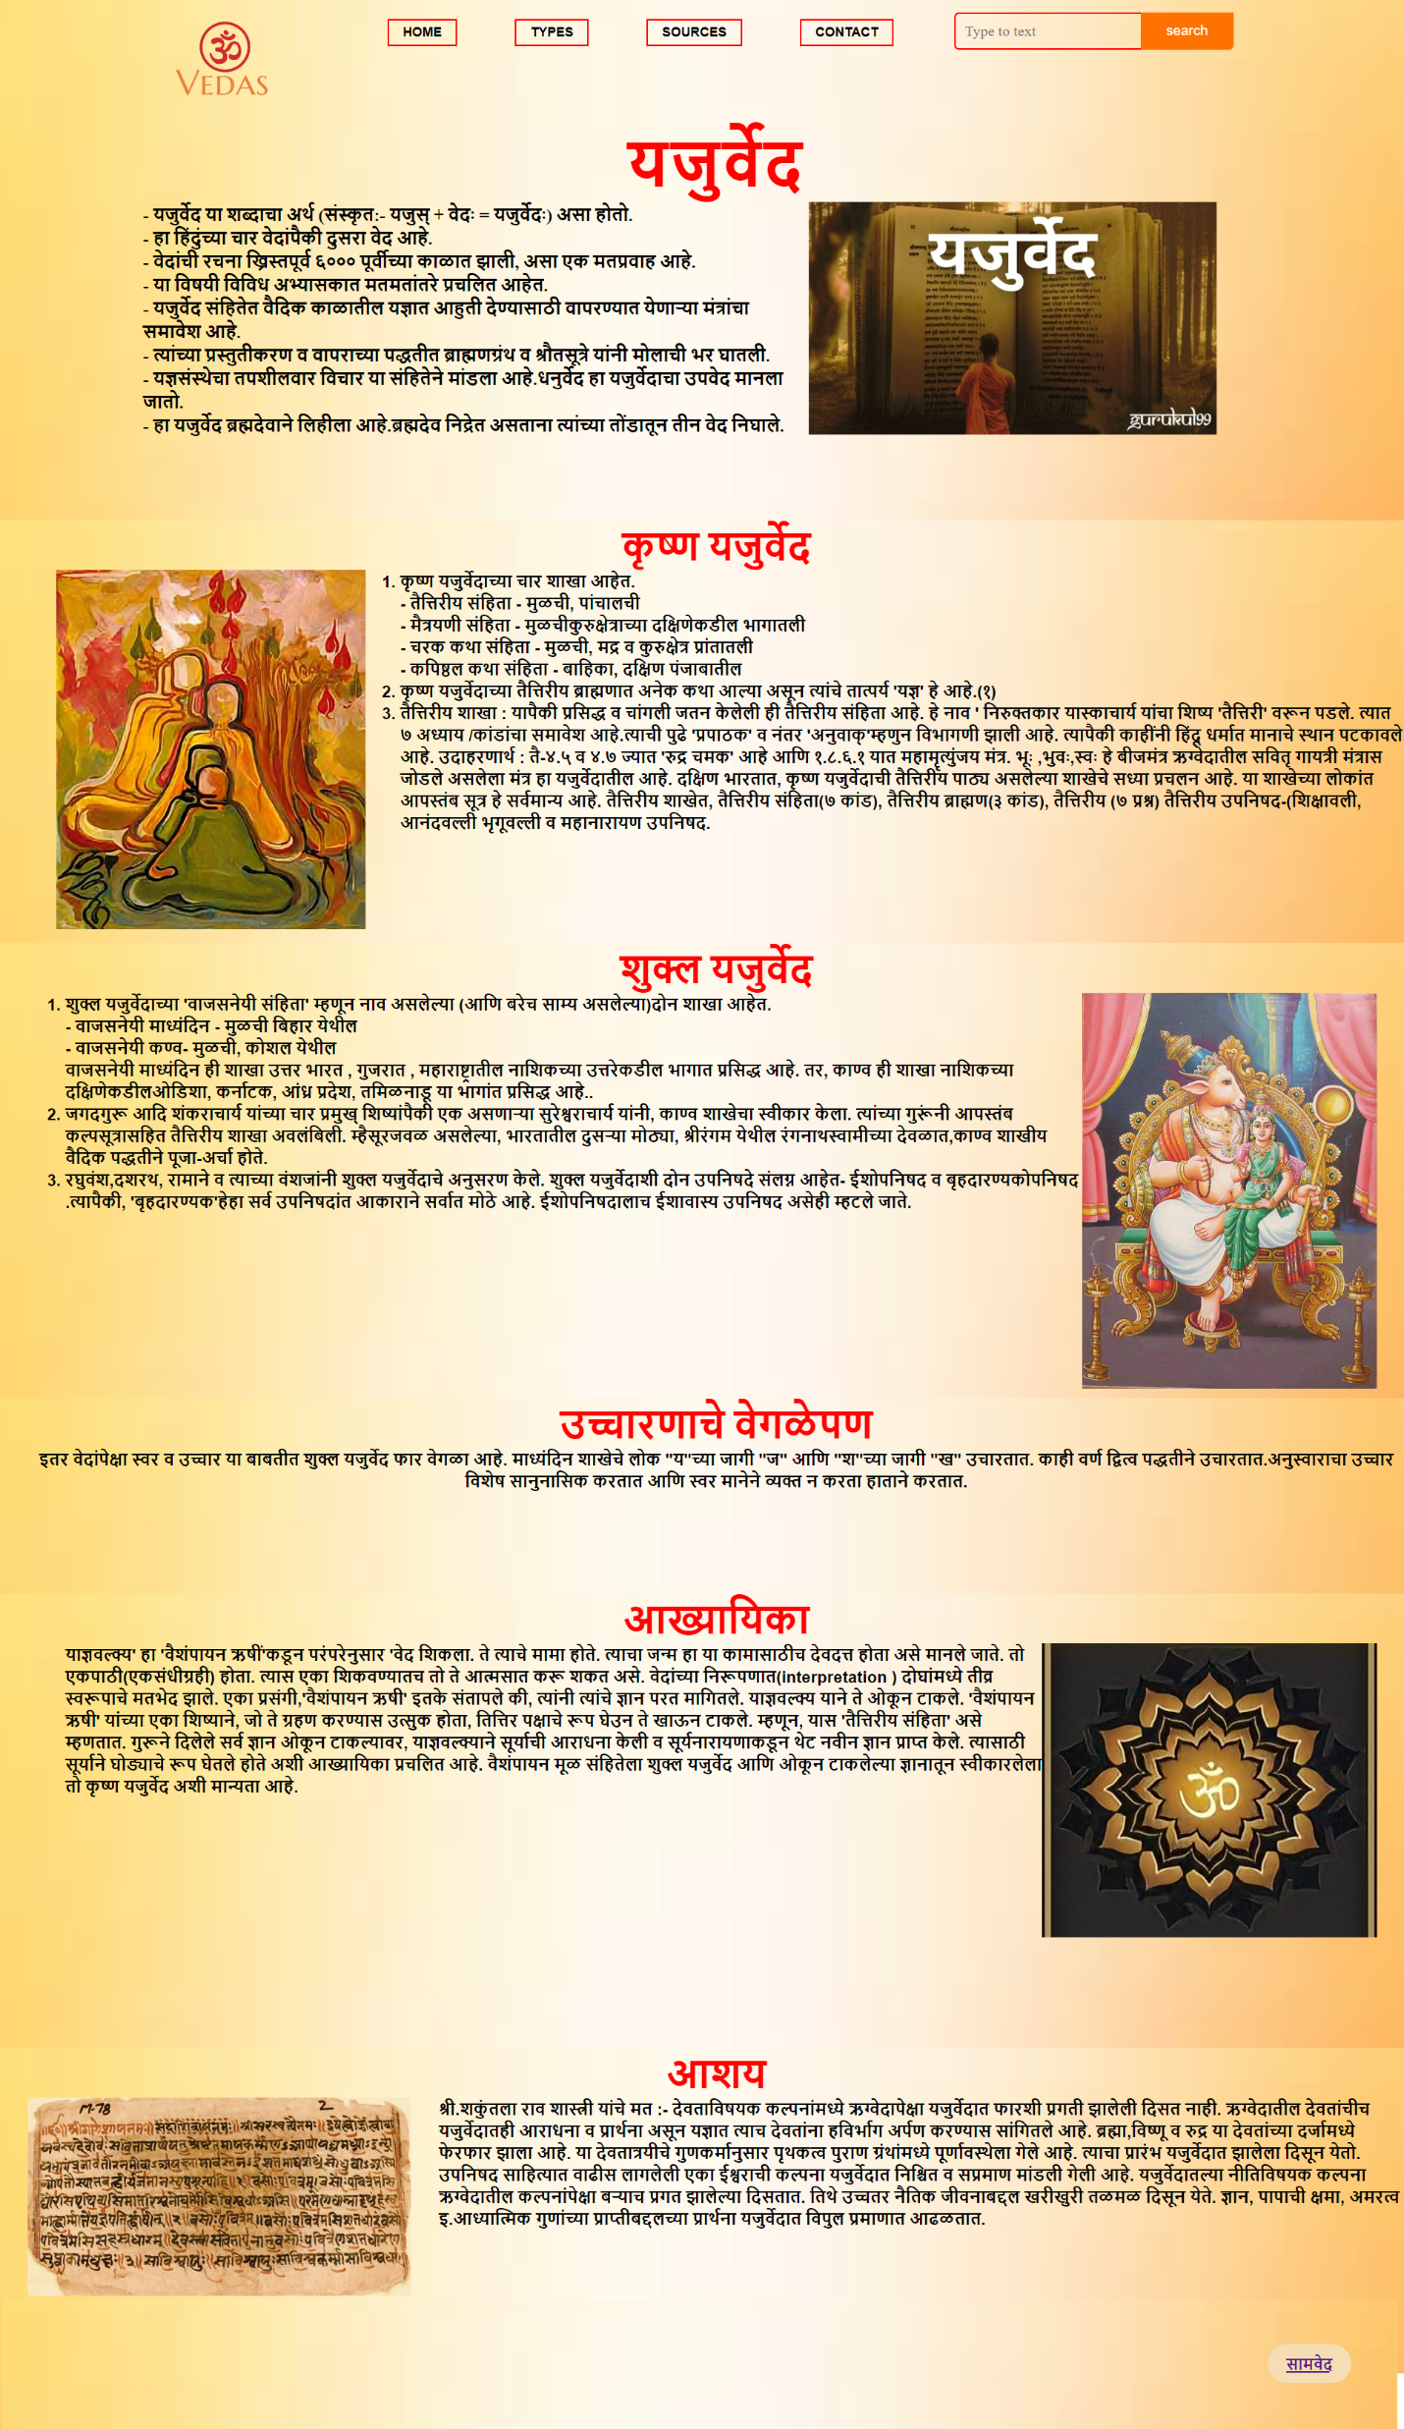
Yajurveda page:

Slide 12
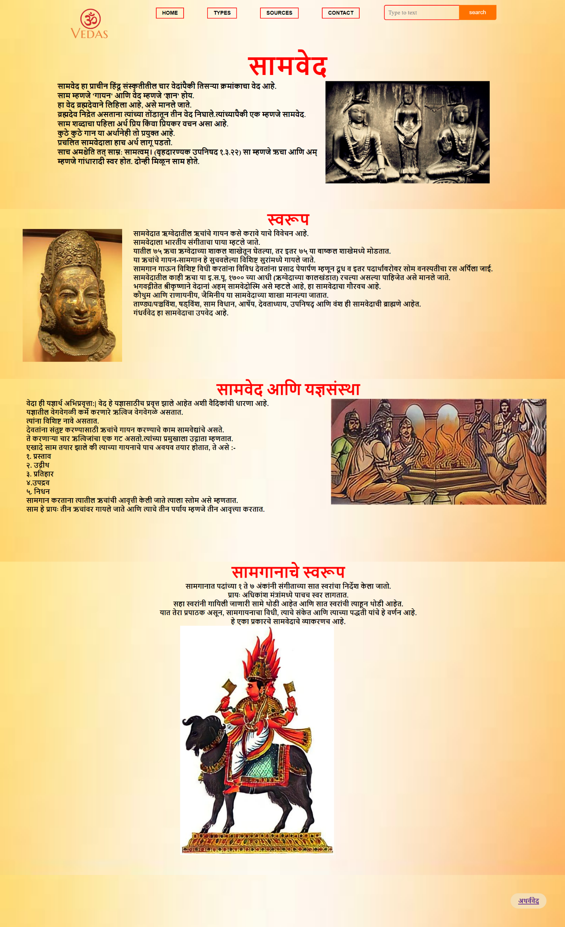
Samaveda page:

Slide 13
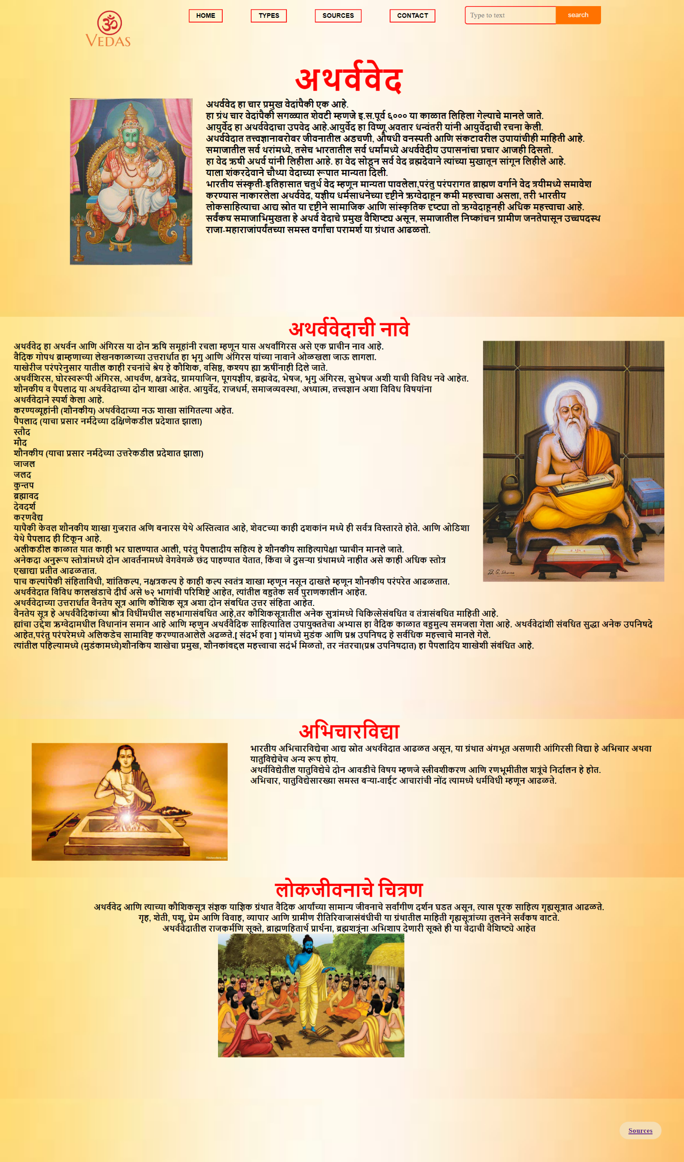
Atharvaveda Page:

Slide 14
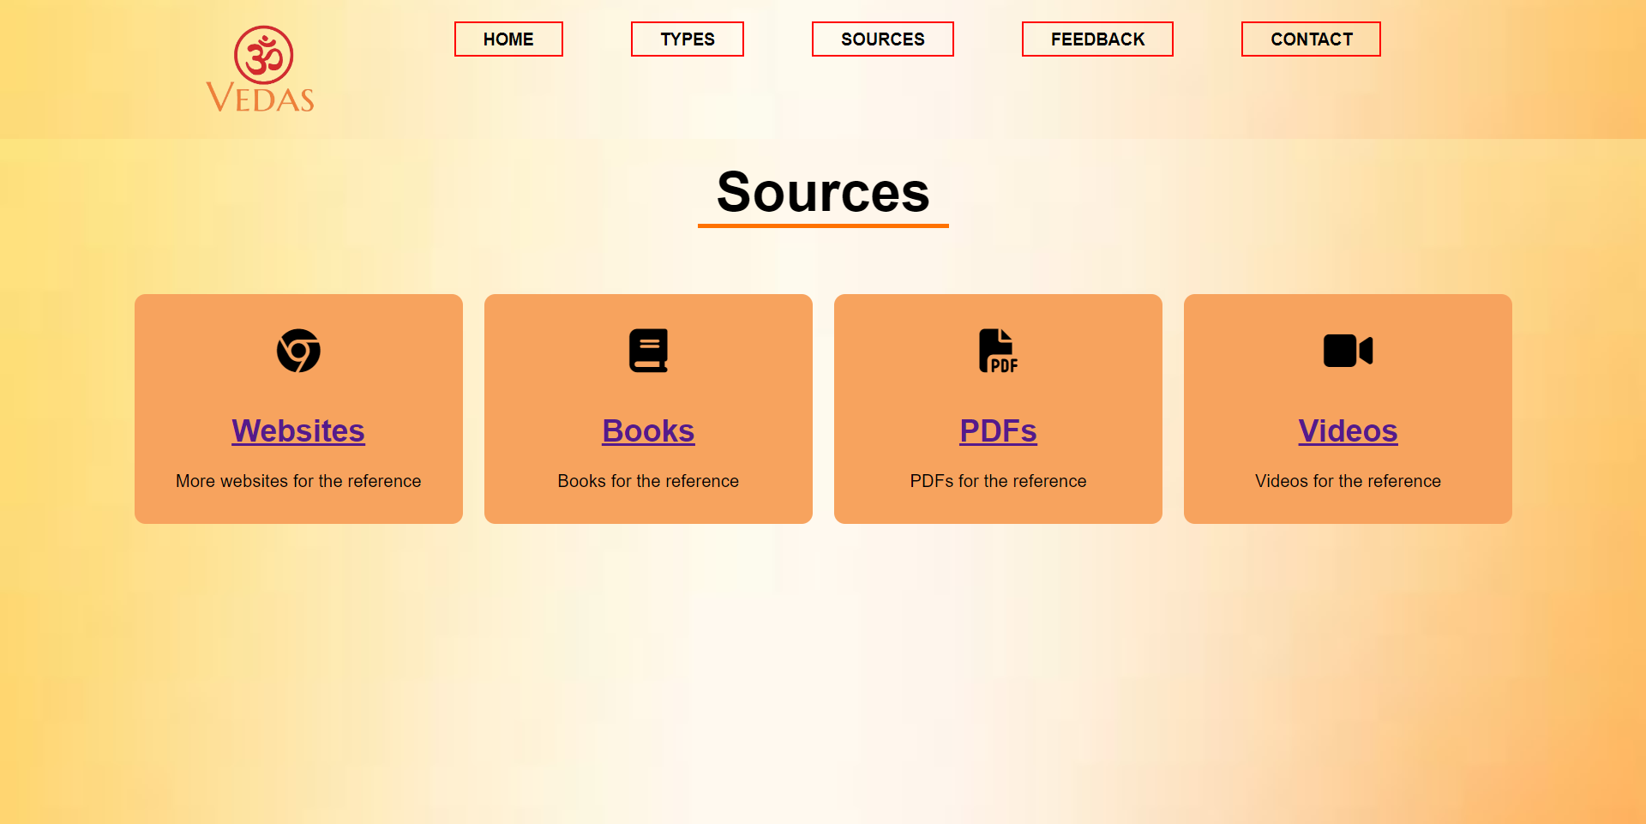
Sources page:

Slide 15
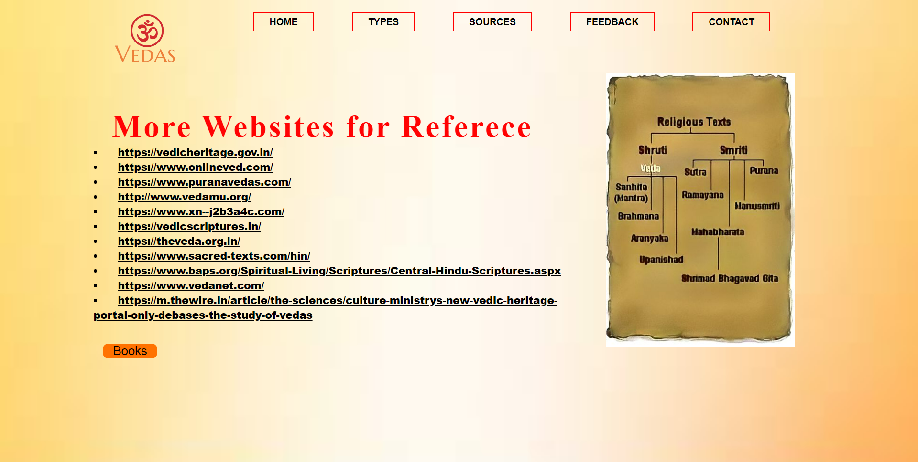
Reference websites page:

Slide 16

Reference Books page:

Slide 17
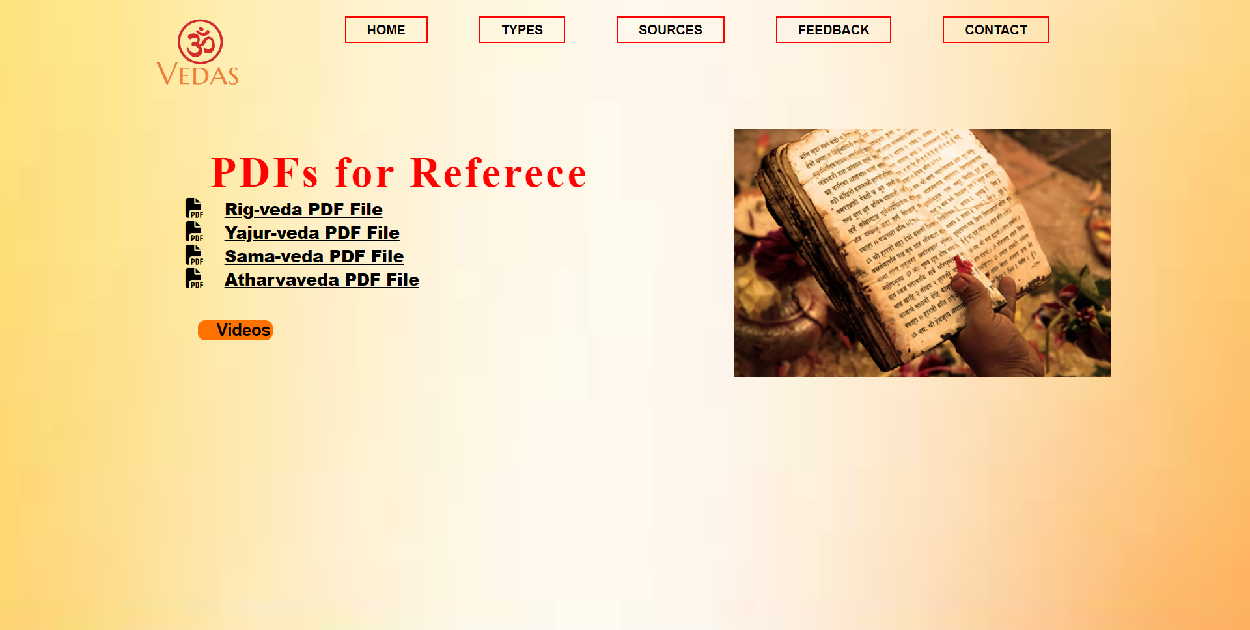
Reference PDFs page:

Slide 18
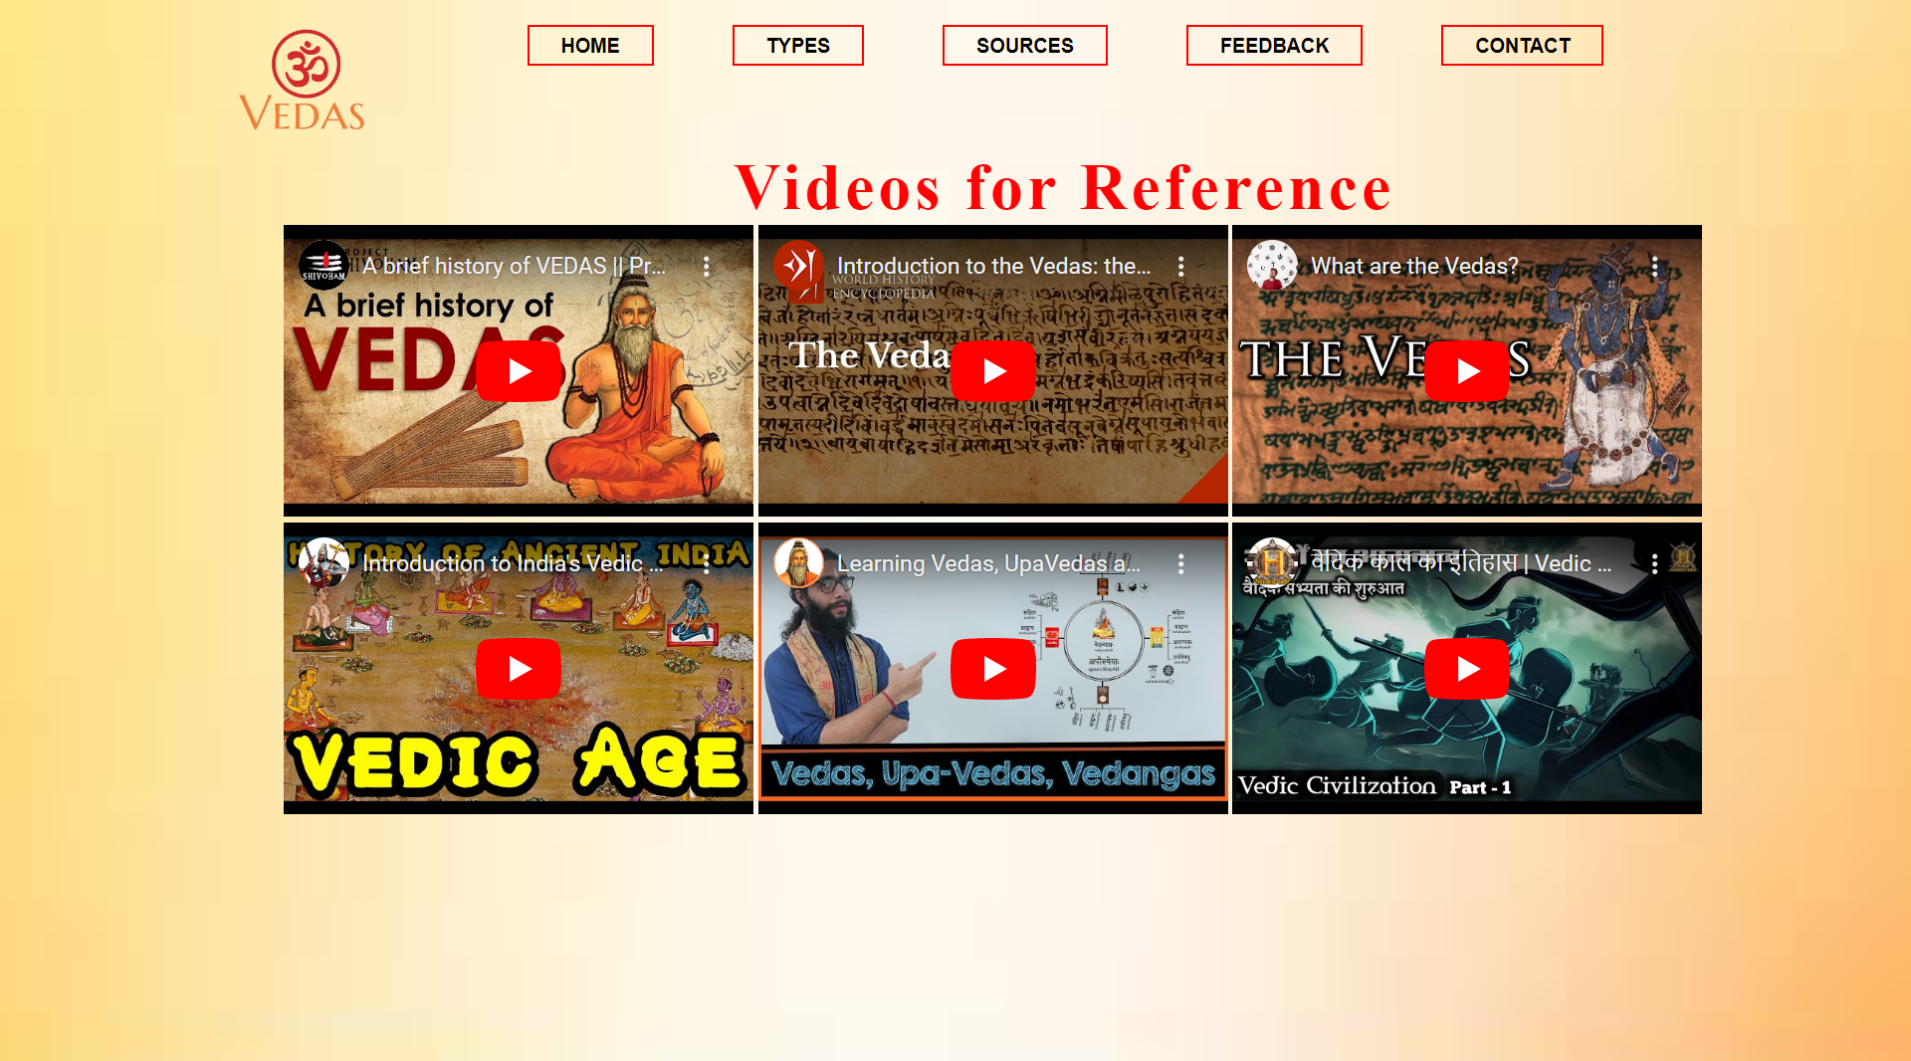
Reference videos page:

Slide 19
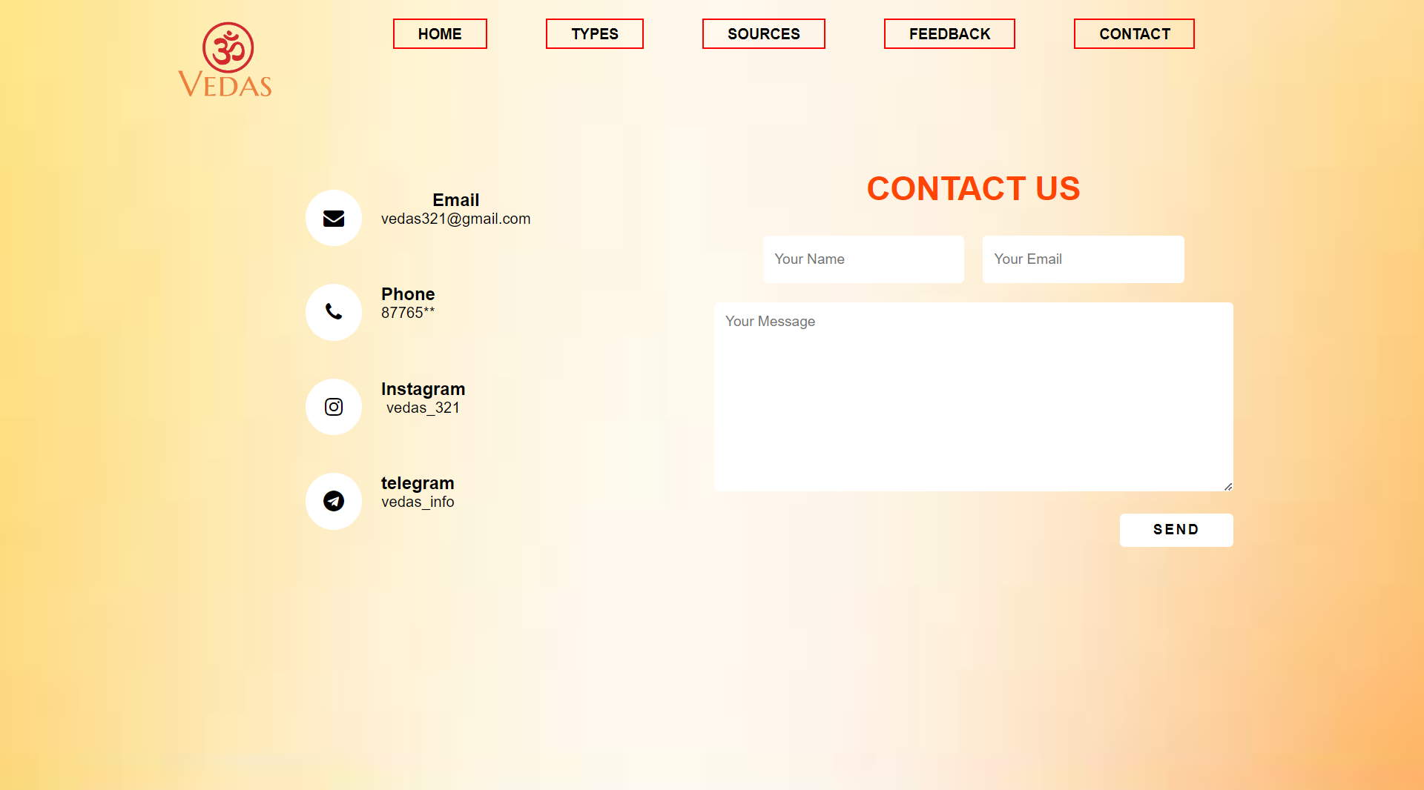
Contact Us Page:

Slide 20
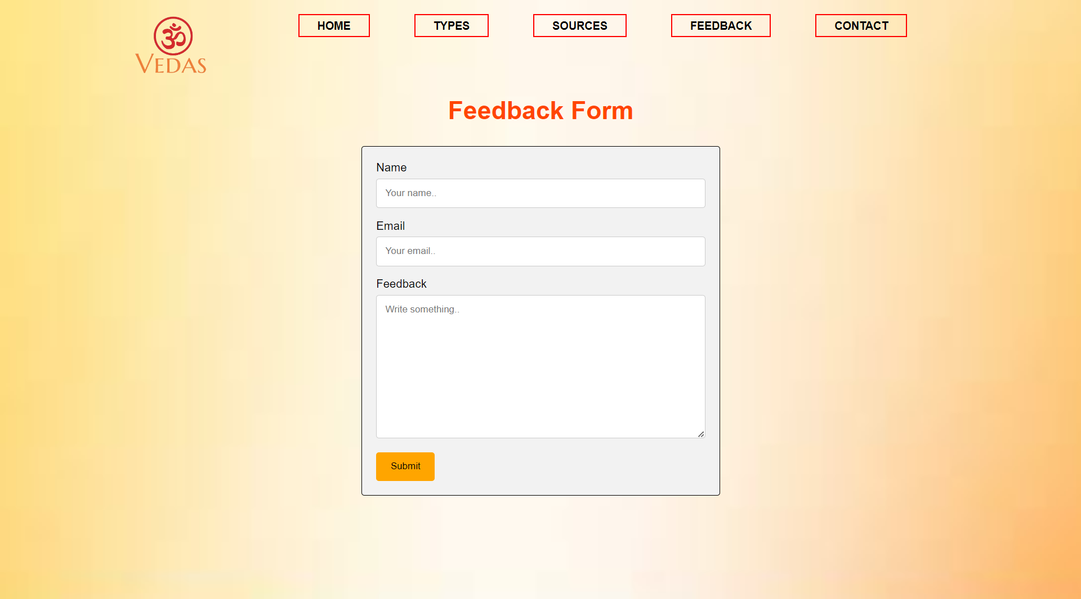
Feedback Page:

